Slide 1
Zoonotic and emergent diseases
Cristina Lanzas
CBS 810 Infectious disease modeling

Slide 2
Learning objectives
Explain the main drivers for emergent diseases
Explain the concepts of reservoir, source and target population, and maintenance population/community
Explain the different phases of zoonotic transmission dynamics
Describe the key elements of multihost models.

Slide 3
Most pathogens can infect more than one host species
> 60 % of all human pathogens are classified as zoonoses
> 75 % of livestock pathogens infect multiple hosts
> 90 % of domestic carnivore pathogens infect multiple hosts
Haydon et al. EID 8: 1468

Slide 4
Zoonoses
Diseases and infection that are naturally transmitted between vertebrate animals and humans.
Disease | Main reservoir | Common mode of transmission to humans
Anthrax | Livestock, wild animals, environment | Direct contact, ingestion
Avian influenza | Poultry, ducks | Direct contact
Brucellosis | Ruminants | Consumption of dairy products
Hantavirus syndromes | Rodents | Aerosol
Plague | Rats and their fleas | Flea bite
Rabies | Dogs, foxes, and bats | Bite

Slide 5
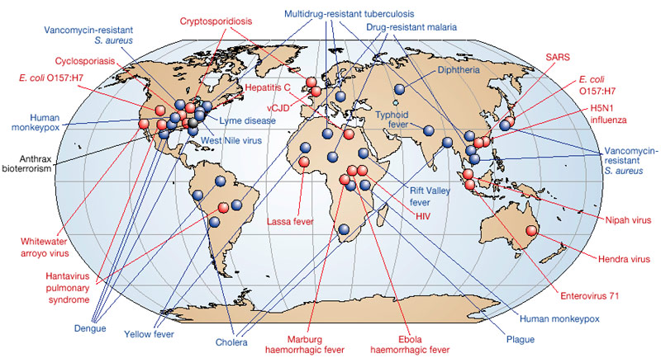
Red represents newly emerging diseases; blue, re-emerging/resurging diseases; black, a 'deliberately emerging' disease.
Morens et al., Nature (2004), 430: 242-9

Slide 6
Factors involved in the emergence of infectious diseases
Microbial adaptation and change
Human susceptibility to infection
Climate and weather
Changing ecosystems
Human demographics and behavior
Economic development and land use
International travel and commerce
Technology and industry
Breakdown of public health measures
Poverty and social inequality
War and famine
Lack of political will
Intent to harm
Morens et al., Nature (2004), 430: 242-9

Slide 7
Drivers and locations of emergence events for zoonotic infectious diseases in humans from 1940-2005
Keesing et al. Nature 468 (2010): 647-

Slide 8
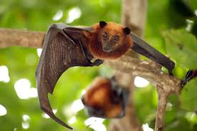
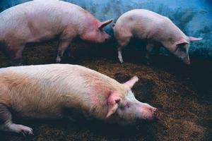
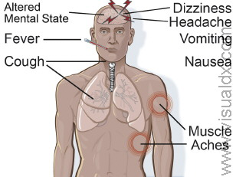
Malaysian Nipah Virus Outbreak
Pigs become infected through
contact with materials contaminated by the
urine, feces or saliva from infected
(carrier) flying foxes.
http://blogs.discovermagazine.com/bodyhorrors/2013/04/30/climatic-ori-nipah-virus/#.VClqPRYXNo0
The virus spread between pigs by direct contact and by aerosol
The mortality rate of Nipah virus infection is 40–75%. Abattoir workers and pig farmers were at greater risk.

Slide 9
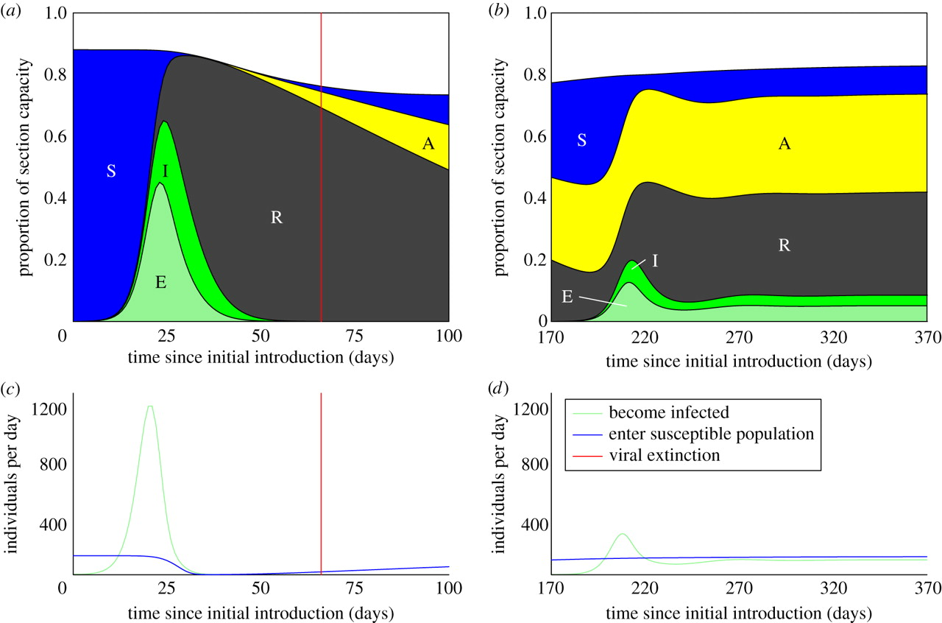

Deterministic model results illustrating Nipah virus dynamics in the growing section of the index farm.
Juliet R. C. Pulliam et al. J. R. Soc. Interface 2012;9:89-101
©2012 by The Royal Society
Notes:
Deterministic model results illustrating Nipah virus dynamics in the growing section of the index farm. Individuals are characterized as belonging to one of five states: susceptible (S), immune—maternal antibodies (A), immune—recovered from infection (R), exposed (E) and infectious (I). The top panels illustrate the infection/immunity profile of the growing section following (a) initial introduction of the virus and (b) subsequent introduction. The population profile is normalized by the capacity of the growing section (see the electronic supplementary material). The qualitative difference in infection dynamics results primarily from the prevalence of maternal antibodies in the young pig population. (c,d) Following the initial introduction of the virus (c), the rate of replenishment of the susceptible population in the growing section (solid blue line) declines, as many individuals are immune, having been infected while in the breeding sections. The rate at which individuals are infected (green line) declines in consequence. When the virus is reintroduced (d), many individuals entering the growing section have maternal antibodies. Loss of maternal antibodies after entry into the growing section provides a source of susceptibles independent of the presence of infection (blue line), allowing the virus to persist. Infection dynamics are qualitatively similar for a wide range of transmission parameters. The results shown were produced using the following combination of transmission parameters: ɛ = 0.5, σ = 0.01 and R0 = 10. Analogous results for introduction into a vaccinated population are shown in the electronic supplementary material.

Slide 10
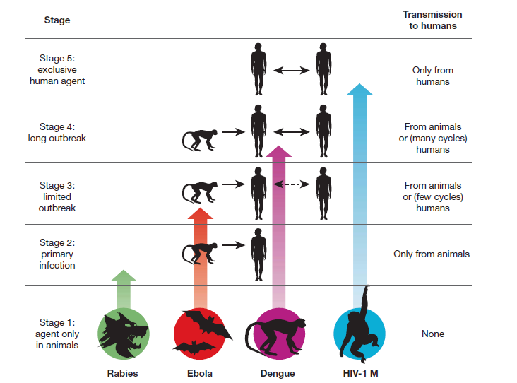
Wolfe et al. Nature 447: 279 (2007)

Slide 11
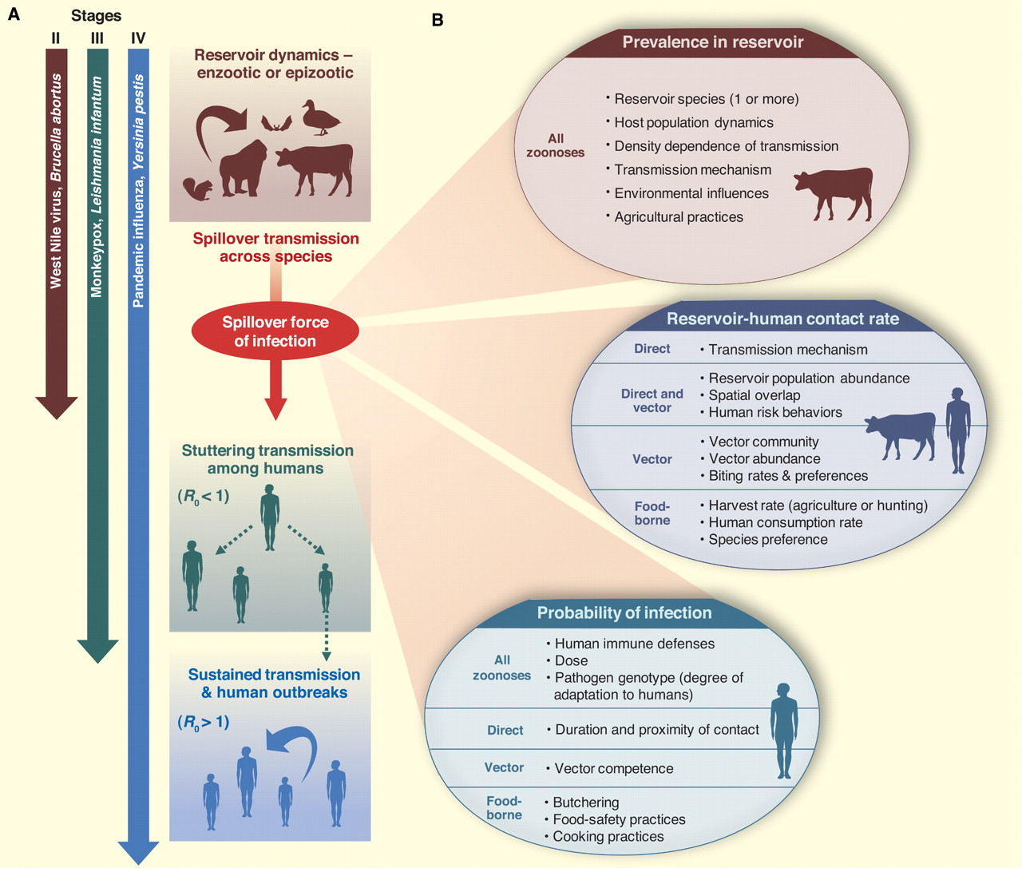
Schematic diagram of zoonotic transmission dynamics
J O Lloyd-Smith et al. Science 2009;326:1362-1367
Notes:
(A) Schematic diagram of zoonotic transmission dynamics. Zoonoses can involve as many as four dynamical phases, including enzootic or epizootic circulation in the animal reservoir, spillover transmission from animals to humans, and sometimes self-limiting stuttering chains of human-to-human transmission or sustained transmission leading to outbreaks. Adapting Wolfe et al. (6), we classify zoonotic pathogens into three stages (II, III, and IV) according to their transmissibility among humans. (B) The spillover force of infection is determined by the product of three major components. The force of infection is defined as the per capita rate of infection of susceptible humans. Beneath each major component is a list of contributing factors drawn from many disciplines; these factors may pertain to all zoonoses or to particular transmission modes, as indicated.

Slide 12
Reservoirs
Target population is the population of concern or interest to us.
Reservoir : one or more epidemiologically connected populations or environments in which the pathogen can be permanently maintained and from which infection is transmitted to the defined target population.
Maintenance population: single host population capable of maintaining a pathogen over the long term.
Maintenance community: Any set of connected host populations that together can maintain a pathogen over the long term.
Haydon et al. EID 8: 1468

Slide 13
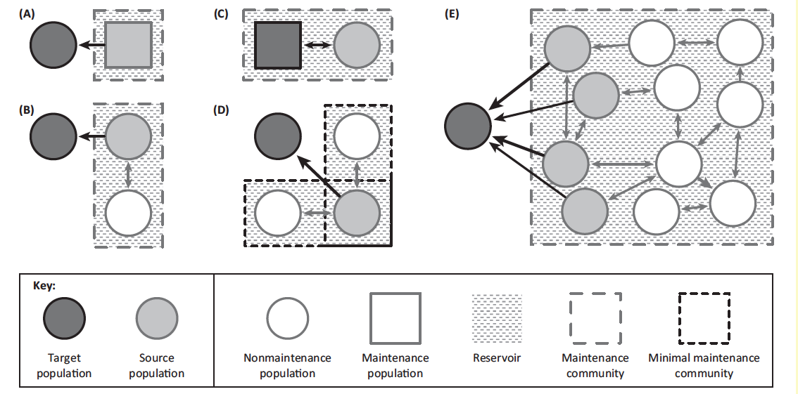
Haydon et al. EID 8: 1468

Slide 14
Multi-host models
Vector-borne models: a secondary obligate host is required for transmission
WAIFW matrix
Multi-host models with “within-host species” and “between-host species”
WAIFW matrix

Slide 15
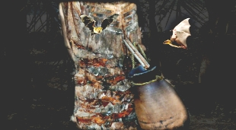
WAIFW are often asymmetric for zoonotic diseases: Nipah virus
B: bats, P: pigs, H: humans
Bangladesh 2013 outbreak, possible contamination by bats in the clay pot collecting date palm sap
http://www.searo.who.int/entity/emerging_diseases/links/nipah_virus/en/

Slide 16
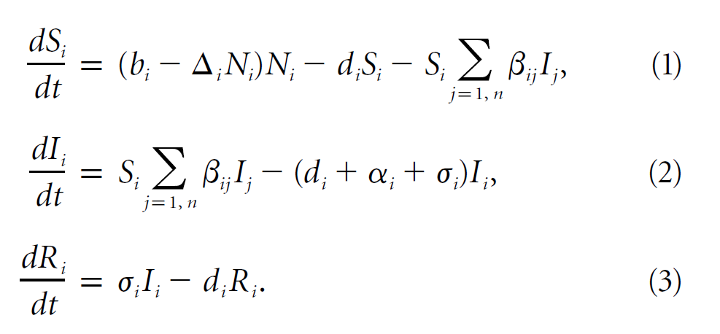
General framework for multi-host models
Multispecies SIR model:
Dobson, Amer Natur 164 (2004)

Slide 17
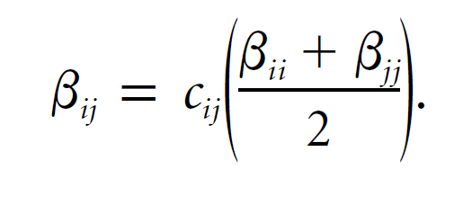
Between-host transmission
cij Proportional scaling parameter that modifies between-species transmission from an arithmetic mean of their within-species rates
cij takes values from 0 to 1 is we assume that species tend to have more interaction with individuals of the same species than with individuals of other species.
Can you think some situations where the between-host transmission is greater than within-host transmission?

Slide 18
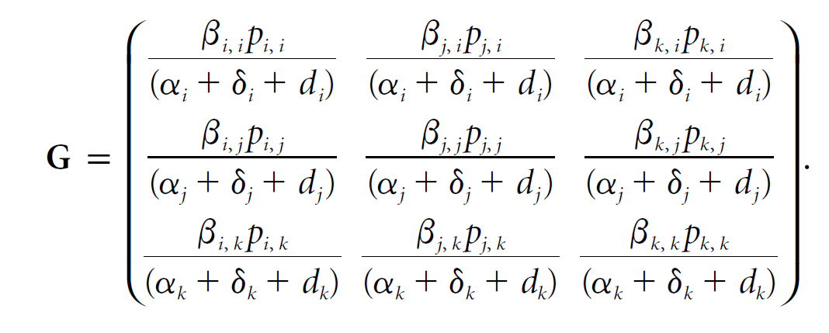
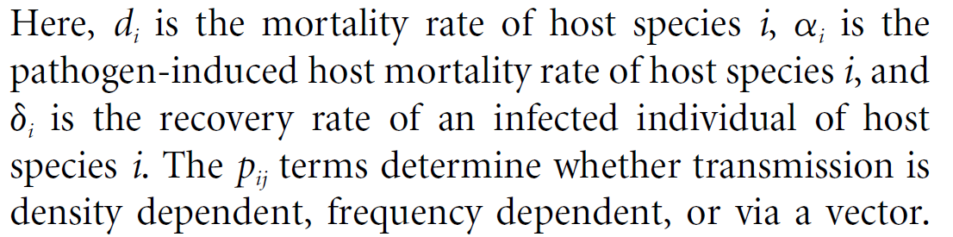
Matrix with reproduction numbers

Slide 19
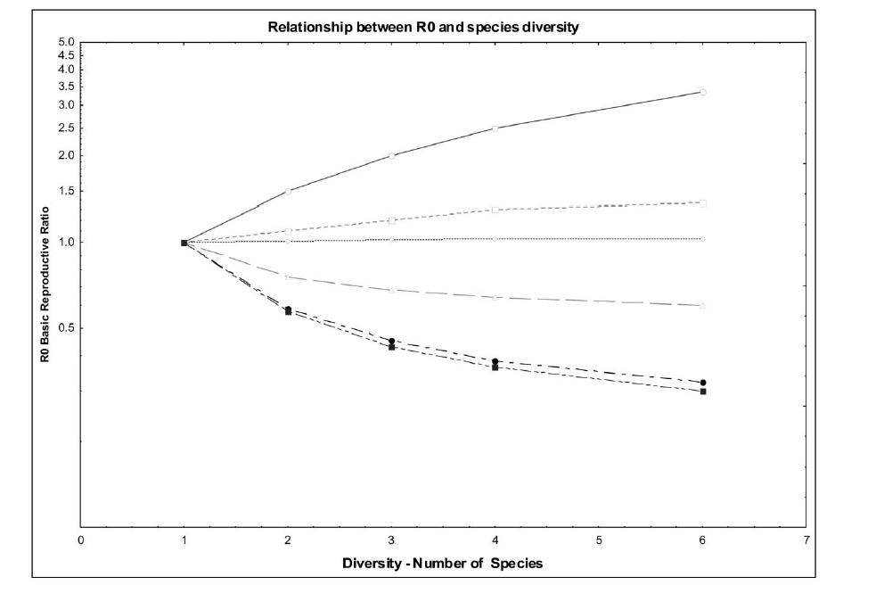
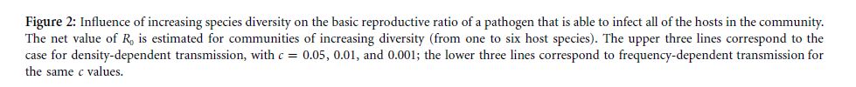
Does increased diversity of host species tend to buffer or amplify disease outbreaks?
Density-dependent transmission
Frequency-dependent transmission
Dobson, Amer Natur 164 (2004)

Slide 20
Reading Material
Dobson, A. Population dynamics of pathogens with multiple host species. American Naturalist 164, S64-S78 (2004).
Lloyd-Smith, J.O., George, D., Pepin, K.M., Pitzer, V.E., Pulliam, J.R.C., Dobson, A.P., Hudson, P.J., Grenfell, B.T., 2009. Epidemic Dynamics at the Human-Animal Interface. Science 326, 1362-1367.

